Slide 1
Breaking Boundaries: Multi-Cloud Red Teaming Through Misconfigurations
@gr33nm0nk2802
Notes:
AI-generated content may be incorrect. --- This presentation explores multi-cloud red teaming, focusing on identifying and exploiting misconfigurations across AWS and Azure. We will cover IAM concepts, attack flows, live demonstrations, and strategies for detection and mitigation in complex cloud environments.

Slide 2
Cloud Red Teaming Agenda
Cloud 101
Red Teaming 101
IAM Concepts
Cloud-Red-Labs Overview and Lab Safety.
Azure Attack Flow and Practical Demonstrations
AWS Attack Flow and Hands-On Demonstrations
Detection and Mitigation Strategies
Q&A Preparation
Notes:
We will begin with an IAM concepts refresher and cross-cloud identity mappings. Next, we'll review the Cloud-Red-Labs repository and lab safety protocols. Then, we'll dive into AWS and Azure attack flows with practical demos. Finally, we'll cover detection, mitigation strategies, incident response, and close with Q&A preparation.

Slide 3

# aws sts get-caller-identity
Syed Modassir Ali a.k.a @gr33nm0nk2802
Offensive Security Engineer. Red Teamer
Community Contributor.
Learn to build and break Stuffs.
https://linkedin.com/in/gr33nm0nk2802
Notes:
We will begin with an IAM concepts refresher and cross-cloud identity mappings. Next, we'll review the Cloud-Red-Labs repository and lab safety protocols. Then, we'll dive into AWS and Azure attack flows with practical demos. Finally, we'll cover detection, mitigation strategies, incident response, and close with Q&A preparation.

Slide 4
Cloud 101
Notes:
This section revisits core IAM principles in AWS and Azure, explains how identities and roles map between the two platforms, and highlights common misconfigurations found in multi-cloud IAM setups.

Slide 5

Cloud 101
Notes:
NIST SP 800-145, The NIST Definition of Cloud Computing

Slide 6

Cloud 101
Notes:
NIST SP 800-145, The NIST Definition of Cloud Computing

Slide 7

Cloud 101

Slide 8
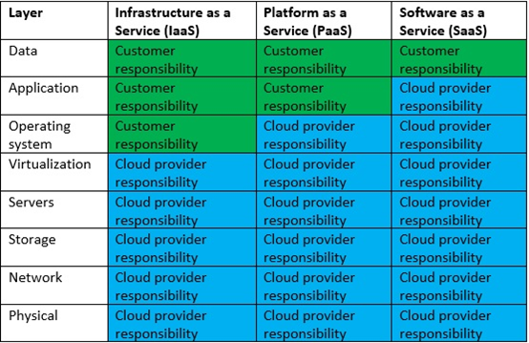
Cloud 101

Slide 9
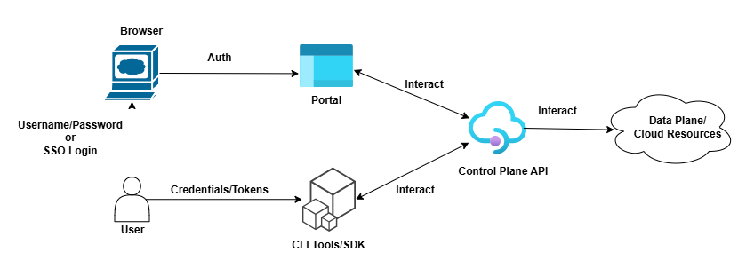
Cloud 101
Control Plane - Control planes provide the administrative APIs used to create, read/describe, update, delete, and list (CRUDL) resources.
Data Plane – Data plane consists of the systems for consuming those resources, which is basically primary function of the service.
Notes:
Control planes and data planes - AWS Fault Isolation Boundaries Control plane and data plane operations - Azure Resource Manager | Microsoft Learn

Slide 10

Red Teaming 101

Slide 11
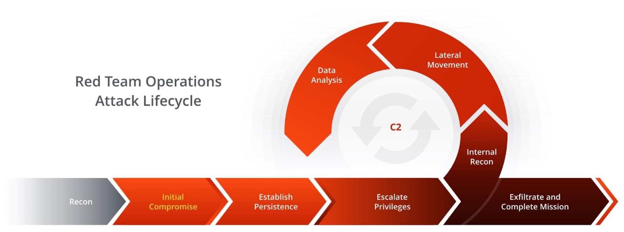
Red Teaming 101

Slide 12
IAM Concepts
Notes:
This section revisits core IAM principles in AWS and Azure, explains how identities and roles map between the two platforms, and highlights common misconfigurations found in multi-cloud IAM setups.

Slide 13
Identity and Access Management
Identity and Access Management (IAM) is the control plane that defines who can perform what actions on which resources(where), under what conditions, and for how long using policies evaluated by the providers control plane.
Everything in cloud IAM is “Who → What → Where → When → How”
Identity and Access Management (IAM)
Identity/Principal (Who)
Authenticate
Authorization (Policy) (What)
Resource (Where)
Condition (When)

Slide 14
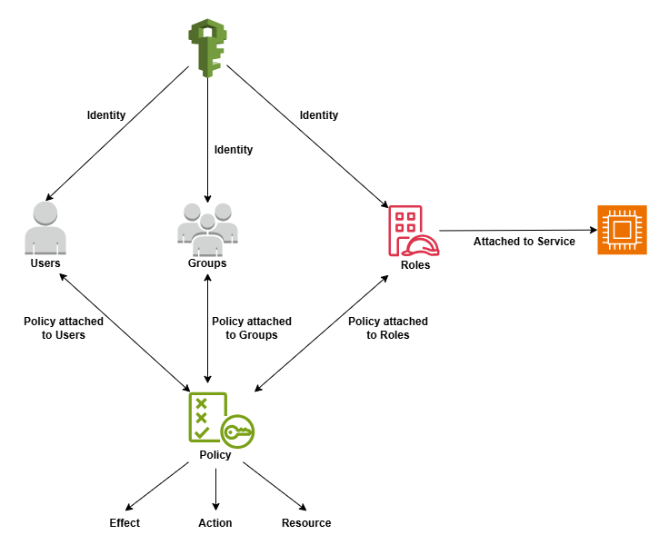
AWS

Slide 15
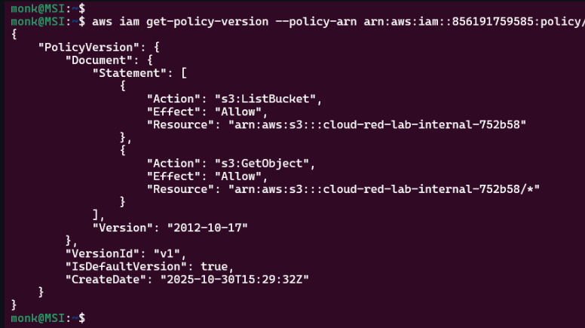
AWS

Slide 16
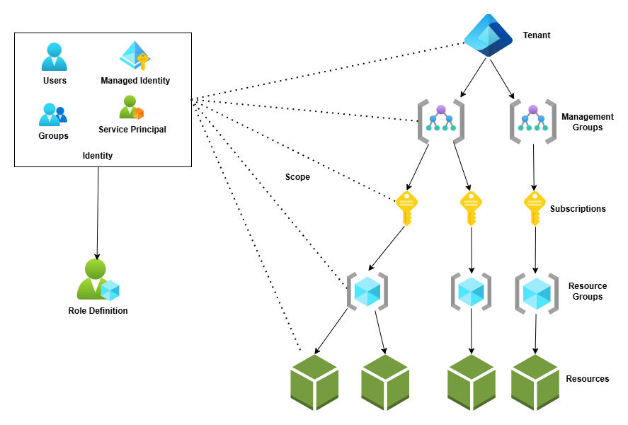
Azure
Permissions are inherited from top to bottom

Slide 17
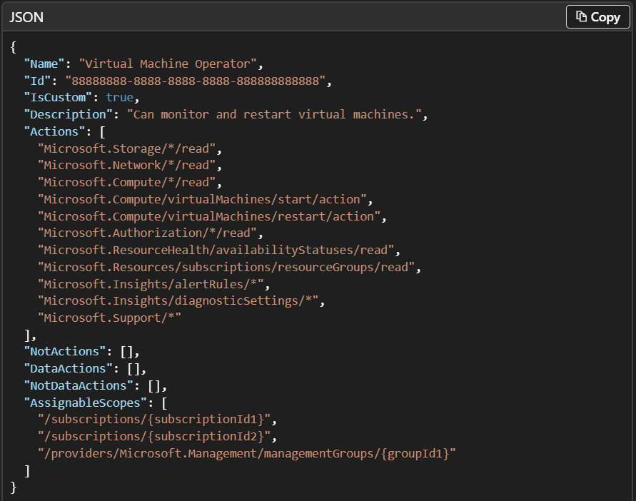
Azure
Notes:
Azure built-in roles - Azure RBAC | Microsoft Learn
Azure custom roles - Azure RBAC | Microsoft Learn

Slide 18

Common Misconfigurations in Multi-Cloud IAM Setups
Overly Permissive Roles
Roles with excessive permissions increase the risk of unauthorized access and potential data breaches.
Improper Trust Relationships
Incorrectly configured trust relationships can allow unintended entities to access sensitive cloud resources.
Inconsistent Policy Management
Discrepancies in policies across clouds create gaps that attackers can exploit for unauthorized access.
Notes:
--- Identify frequent misconfiguration patterns in multi-cloud IAM, such as overly permissive roles, improper trust relationships, and inconsistent policy management that expose security risks. Image source: Microsoft 365 content library

Slide 19
Cloud-Red-Labs
Notes:
Gain an overview of the Cloud-Red-Labs repository structure and learn how to set up and use labs safely, ensuring a secure and controlled environment to practice red teaming techniques.

Slide 20
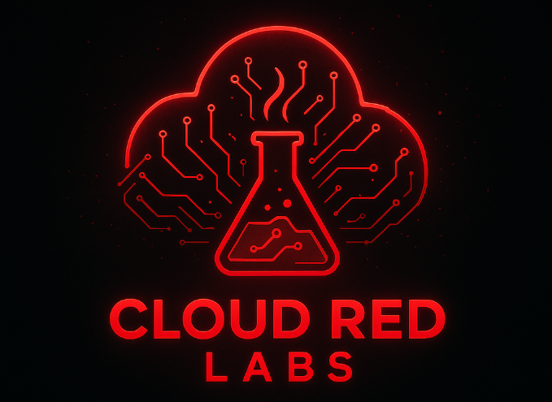

Cloud Red Labs
Notes:
https://github.com/gr33nm0nk2802/Cloud-Red-Labs

Slide 21
Pre-Requisites
AWS CLI
AZ CLI
Powershell
Defcon Wi-Fi/Backup Hotspot
A Web Browser
Notes:
https://github.com/gr33nm0nk2802/Cloud-Red-Labs

Slide 22

Reference Document
Please scan the below to access the application details or navigate to https://shorturl.fm/rn36C

Slide 23
Azure Attack Path
Notes:
Dive into a typical Azure attack flow with practical demonstrations on RBAC discovery, privilege escalation, identity metadata service abuse, and persistence mechanisms.

Slide 24
Initial Access
Phishing for Users in the Tenant.
Exposed secrets.
Remote Code Execution by exploitation of Public Facing Infrastructure.
N.B: In this case we will exploit SSTI on an application.
Notes:
Server-side template injection | Web Security Academy

Slide 25
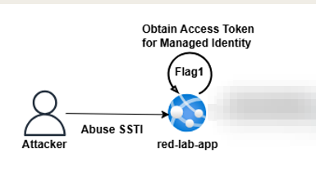

Slide 26
Internal Recon
Using the Managed Identity token, we can try to enumerate for resources under our given subscription.
Look around for common services like Compute, Secret Management and Storage services.
Notes:
Server-side template injection | Web Security Academy

Slide 27
Lateral Movement
Using the SSTI, and the correct resource get the Key Vault token.
Using the Key Vault token try to fetch sensitive data from the Key Vault.
Notes:
Server-side template injection | Web Security Academy

Slide 28
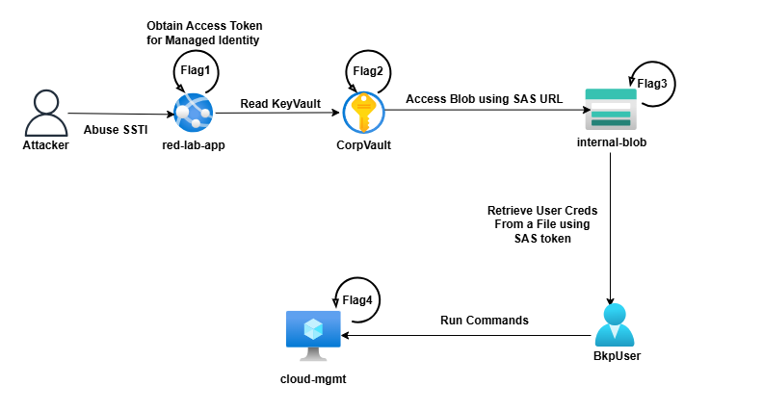

Slide 29
Data Exfiltration
Using the SAS URL recovered from the Key Vault try to enumerate for other sensitive files.
Using the files try to gain persistence backdoor to the environment.
Notes:
Server-side template injection | Web Security Academy

Slide 31
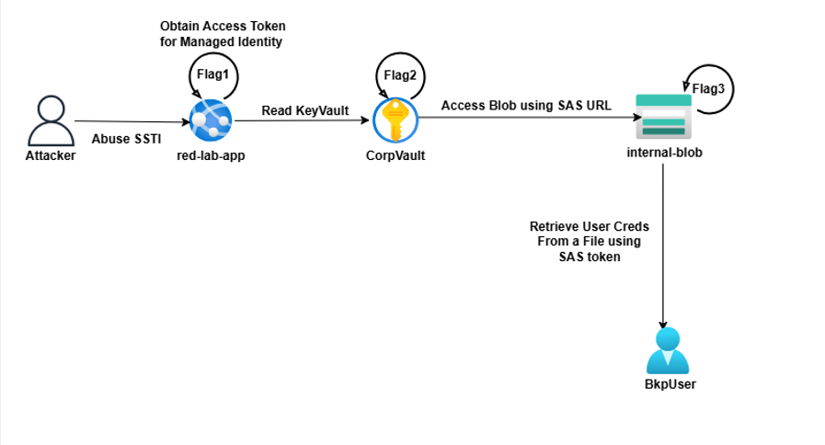

Slide 32
Privilege Escalation
Q. What attack vectors are possible once we compromise the bkpuser.
Notes:
Server-side template injection | Web Security Academy

Slide 34
AWS Attack Path
Notes:
This section covers a typical AWS attack flow and features hands-on live demonstrations illustrating IAM enumeration, AssumeRole chaining, lateral movement, and data exfiltration techniques.

Slide 35
Initial Access
Phishing for Users in the Cloud.
Exposed secrets.
Remote Code Execution by exploitation of Lambda Function.
N.B: In this case we will exploit command execution on an application.
Notes:
Server-side template injection | Web Security Academy

Slide 36
Initial Access
Difference between Short Term and Long-Term Credentials.
Notes:
Server-side template injection | Web Security Academy

Slide 37
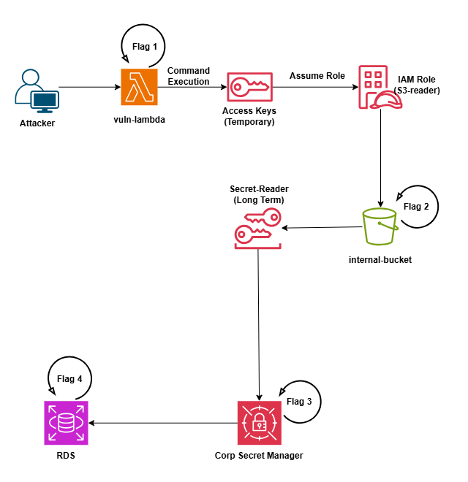
Notes:
Server-side template injection | Web Security Academy

Slide 38
Internal Recon
Enumerate the Roles, Permissions and see what services we have access within the environment.
Notes:
Server-side template injection | Web Security Academy

Slide 39
Privilege Escalation and Lateral Movement
Assume a role to read secrets from the s3 bucket. (Data Exfiltration)
Abused the Long-Term Secrets. (Persistence.)
Notes:
Server-side template injection | Web Security Academy

Slide 40
Notes:
Server-side template injection | Web Security Academy

Slide 41
Data Exfiltration
Try to extract secrets using the newly found credentials.
Final Task: Use what we have identified so far to find out the Final Flag.
Notes:
Server-side template injection | Web Security Academy

Slide 42
Notes:
Server-side template injection | Web Security Academy

Slide 43
Detection and Mitigation Strategies
Notes:
Discover tips for delivering engaging demos, along with guidance on detection, logging, and concrete mitigation steps for common multi-cloud misconfigurations.

Slide 44
How to Detect and Mitigate
Cloud detection is all about visibility and correlation.
Enable logs, feed them into Guard Duty/Defender, and monitor changes to identity, logging, and data access.
Step 1: Collect → Enable logs (CloudTrail / Activity Logs / Sign-in Logs).
Step 2: Analyze → Use Guard Duty or Defender for Cloud to find suspicious patterns.
Step 3: Correlate → Send everything to a SIEM (Security Hub / Sentinel).
Step 4: Respond → Trigger alerts or automated playbooks (disable account, isolate VM).
Notes:
Server-side template injection | Web Security Academy

Slide 45

Q&A
Notes:
--- Review actionable recommendations to fix typical IAM and configuration errors, reducing exposure and strengthening cloud security posture. Image source: Microsoft 365 content library

